Slide 1

UNIT-I
19.<number>
Copyright © The McGraw-Hill Companies, Inc. Permission required for reproduction or display.

Slide 2
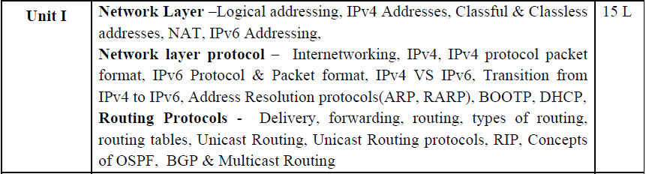
19.<number>

Slide 3
Chapters for Unit 1
Data Communication & Networking (Forouzan) , Tata McGraw-Hill Education
chapter 19 Network Layer: Logical Addressing
chapter 20 Network Layer: Internet Protocol
chapter 21 network Layer: Address Mapping
chapter 22 Network Layer: Delivery, Forwarding, and Routing
19.<number>

Slide 4
Chapter 20
Network Layer:
Internet Protocol
19.<number>
Copyright © The McGraw-Hill Companies, Inc. Permission required for reproduction or display.

Slide 5
Objectives
In the Internet model, the main network protocol is the Internet Protocol (IP).
In this chapter, we first discuss internetworking and issues related to the network layer protocol in general.
We then discuss the current version of the Internet Protocol, version 4, or IPv4.
This leads us to the next generation of this protocol, or IPv6, which may become the dominant protocol in the near future.
Finally, we discuss the transition strategies from IPv4 to IPv6.
19.<number>

Slide 6
INTERNETWORKING
The physical and data link layers of a network operate locally.
These two layers are jointly responsible for data delivery on the network from one node to the next, as shown in Figure 20.1.
This internetwork is made of five networks: four LANs and one WAN.
If host A needs to send a data packet to host D, the packet needs to go first from A to R1 (a switch or router), then from R1 to R3, and finally from R3 to host D.
We say that the data packet passes through three links.
19.<number>

Slide 7
In each link, two physical and two data link layers are involved. However, there is a big problem here.
When data arrive at interface f1 of R1, how does R1 know that interface f3 is the outgoing interface?
There is no provision in the data link (or physical) layer to help R1 make the right decision.
The frame does not carry any routing information either.
The frame contains the MAC address of A as the source and the MAC address of R1 as the destination. For a LAN or a WAN, delivery means carrying the frame through one link, and not beyond.
19.<number>

Slide 8

Figure 20.1 Links between two hosts
19.<number>

Slide 9
Need for Network Layer
To solve the problem of delivery through several links, the network layer (or the internetwork layer, as it is sometimes called) was designed.
The network layer is responsible for host-to-host delivery and for routing the packets through the routers or switches.
Figure 20.2 shows the same internetwork with a network layer added.
19.<number>

Slide 10

Network layer in an internetwork
19.<number>

Slide 11
Figure 20.3 shows the general idea of the functionality of the network layer at a source, at a router, and at the destination.
The network layer at the source is responsible for creating a packet from the data coming from another protocol (such as a transport
layer protocol or a routing protocol).
The header of the packet contains, among other information, the logical addresses of the source and destination.
The network layer is responsible for checking its routing table to find the routing information (such as the outgoing interface of the packet or the physical address of the next node).
If the packet is too large, the packet is fragmented (fragmentation is discussed later in this chapter).
19.<number>

Slide 12


Fig 20.3 Network layer at the source, router, and destination
19.<number>

Slide 13
The network layer at the switch or router is responsible for routing the packet.
When a packet arrives, the router or switch consults its routing table and finds the interface from which the packet must be sent.
The packet, after some changes in the header, with the routing information is passed to the data link layer again.
• The network layer at the destination is responsible for address verification; it makes sure that the destination address on the packet is the same as the address of the host.
If the packet is a fragment, the network layer waits until all fragments have arrived, and then reassembles them and delivers the reassembled packet to the transport layer.
19.<number>

Slide 14
Internet as a Datagram Network
The Internet, at the network layer, is a packet-switched network.
. We said that, in general, switching can be divided into three broad categories: circuit switching, packet switching, and message switching.
Packet switching uses either the virtual circuit approach or the datagram approach.
The Internet has chosen the datagram approach to switching in the network layer.
It uses the universal addresses defined in the network layer to route packets from the source to the destination.
19.<number>

Slide 15
Internet as a Connectionless Network
Delivery of a packet can be accomplished by using either a connection-oriented or a connectionless network service.
In a connection-oriented service, the source first makes a connection with the destination before sending a packet.
When the connection is established, a sequence of packets from the same source to the same destination can be sent one after another. In this case, there is a relationship between packets.
They are sent on the same path in sequential order. A packet is logically connected to the packet traveling before it and to the packet traveling after it.
When all packets of a message have been delivered, the connection is terminated.
19.<number>

Slide 16
In a connection-oriented protocol, the decision about the route of a sequence of packets with the same source and destination addresses can be made only once, when the connection is established.
Switches do not recalculate the route for each individual
packet.
In connectionless service, the network layer protocol treats each packet independently, with each packet having no relationship to any other packet.
The packets in a message mayor may not travel the same path to their destination. This type of service is used in the datagram approach to packet switching.
The Internet has chosen this type of service at the network layer
19.<number>

Slide 17
The reason for this decision is that the Internet is made of so many heterogeneous networks that it is almost impossible to create a connection from the source to the destination without knowing the nature of the networks in advance.
19.<number>

Slide 18
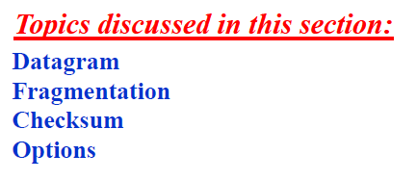
IPv4
The Internet Protocol version 4 (IPv4) is the delivery mechanism used by the TCP/IP protocols.
19.<number>

Slide 19
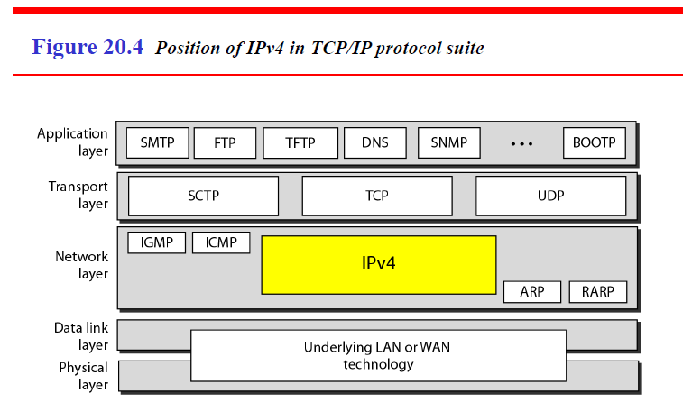
19.<number>

Slide 20
IPv4 is an unreliable and connectionless datagram protocol-a best-effort delivery
service.
The term best-effort means that IPv4 provides no error control or flow control (except for error detection on the header).
IPv4 assumes the unreliability of the underlying layers and does its best to get a transmission through to its destination, but with no guarantees.
If reliability is important, IPv4 must be paired with a reliable protocol such as TCP.
An example of a more commonly understood best-effort delivery service is the post office. The post office does its best to deliver the mail but does not always succeed. If an unregistered letter is lost, it is up to the sender or would-be recipient to discover the loss and rectify the problem. The post office itself does not keep track of every letter and cannot notify a sender of loss or damage.
19.<number>

Slide 21
IPv4 is also a connectionless protocol for a packet-switching network that uses the datagram approach .
This means that each datagram is handled independently, and each datagram can follow a different route to the destination.
This implies that datagrams sent by the same source to the same destination could arrive out of order.
Also, some could be lost or corrupted during transmission. Again, IPv4 relies on a higher-level protocol to take care of all these problems.
19.<number>

Slide 22
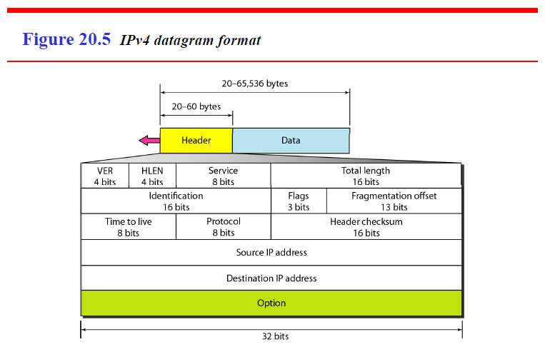
Datagram
Packets in the IPv4 layer are called datagrams. Figure 20.5 shows the IPv4 datagram format.
19.<number>

Slide 23
A datagram is a variable-length packet consisting of two parts: header and data.
The header is 20 to 60 bytes in length and contains information essential to routing and delivery. It is customary in TCP/IP to show the header in 4-byte sections.
A brief description of each field is in order.
Version (VER). This 4-bit field defines the version of the IPv4 protocol. Currently the version is 4. However, version 6 may totally replace version 4 in the future.
This field tells the IPv4 software running in the processing machine that the datagram has the format of version 4.
All fields must be interpreted as specified in the fourth version of the protocol. If the machine is using some other version of IPv4, the datagram is discarded rather than interpreted incorrectly.
19.<number>

Slide 24
2. Header length (HLEN). This 4-bit field defines the total length of the datagram header in 4-byte words.
This field is needed because the length of the header is variable (between 20 and 60 bytes).
When there are no options, the header length is 20 bytes, and the value of this field is 5 (5 x 4 = 20).
When the option field is at its maximum size, the value of this field is 15 (15 x 4 = 60).
19.<number>

Slide 25
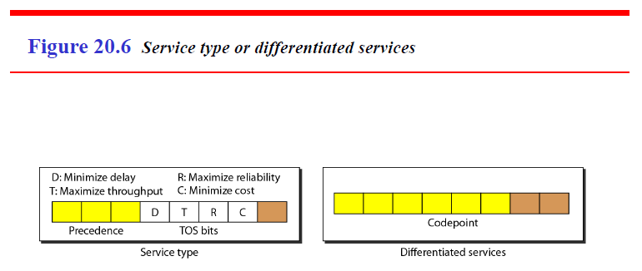
3. Services. IETF(Internet Engineering Task Force) has changed the interpretation and name of this 8-bit field. This field, previously called service type, is now called differentiated services.
We show both interpretations in Figure 20.6.
19.<number>

Slide 26
Service Type
In this interpretation, the first 3 bits are called precedence bits. The next 4 bits are called type of service (TOS) bits, and the last bit is not used.
a. Precedence is a 3-bit subfield ranging from 0 (000 in binary) to 7 (111 in binary). The precedence defines the priority of the datagram in issues such as congestion.
If a router is congested and needs to discard some datagrams, those datagrams with lowest precedence are discarded first. Some datagrams in the Internet are more important than others.
For example, a datagram used for network management is much more urgent and important than a datagram containing optional information for a group.
19.<number>

Slide 27
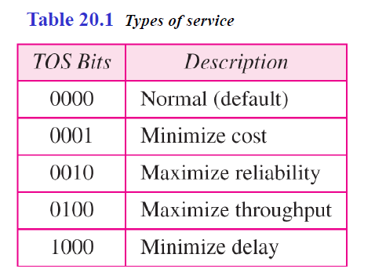
b. TOS bits is a 4-bit subfield with each bit having a special meaning. Although a bit can be either 0 or 1, one and only one of the bits can have the value of 1 in each datagram. The bit patterns and their interpretations are given in Table 20.1.
With only 1 bit set at a time, we can have five different types of services.
19.<number>

Slide 28
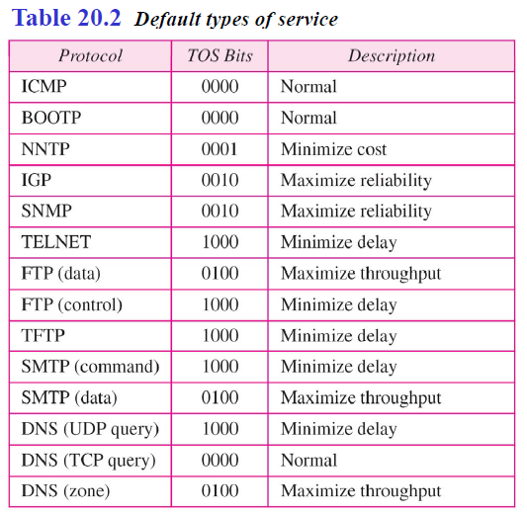
Application programs can request a specific type of service. The defaults for some applications are shown in Table 20.2.
19.<number>

Slide 29
It is clear from Table 20.2 that interactive activities, activities requiring immediate attention, and activities requiring immediate response need minimum delay.
Those activities that send bulk data require maximum throughput. Management activities need maximum reliability. Background activities need minimum cost.
2. Differentiated Services
In this interpretation, the first 6 bits make up the codepoint subfield, and the last 2 bits are not used.
The codepoint subfield can be used in two different ways.
a. When the 3 rightmost bits are Os, the 3 leftmost bits are interpreted the same as the precedence bits in the service type interpretation. In other words, it is compatible with the old interpretation.
19.<number>

Slide 30
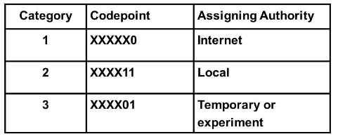
b. When the 3 rightmost bits are not all Os, the 6 bits define 64 services based on the priority assignment by the Internet or local authorities according to Table 20.3.
The first category contains 32 service types; the second and the third each contain 16.
The first category (numbers 0, 2,4, ... ,62) is assigned by the Internet authorities (IETF).
The second category (3, 7, 11, 15, , 63) can be used by local authorities
(organizations).
The third category (1, 5, 9, ,61) is temporary and can be used for experimental purposes.
19.<number>

Slide 31
Note that the numbers are not contiguous.
If they were, the first category would range from 0 to 31, the second from 32 to 47, and the third from 48 to 63.
This would be incompatible with the TOS interpretation because XXXOOO (which includes 0, 8, 16, 24, 32, 40, 48, and 56) would fall into all three categories.
Instead, in this assignment method all these services belong to category 1.
Note that these assignments have not yet been finalized.
19.<number>

Slide 32
4. Total length. This is a In-bit field that defines the total length (header plus data) of the IPv4 datagram in bytes.
To find the length of the data coming from the upper layer, subtract the header length from the total length.
The header length can be found by multiplying the value in the HLEN field by 4.
Length of data =total length - header length
Since the field length is 16 bits, the total length of the IPv4 datagram is limited to 65,535 (216 - 1) bytes, of which 20 to 60 bytes are the header and the rest is data from the upper layer.
19.<number>

Slide 33
Though a size of 65,535 bytes might seem large, the size of the IPv4 datagram may increase in the near future as the underlying technologies allow even more throughput (greater bandwidth).
Some physical networks are not able to encapsulate a datagram of 65,535 bytes in their frames.
The datagram must be fragmented to be able to pass through those networks.
One may ask why we need this field anyway.
When a machine (router or host) receives a frame, it drops the header and the trailer, leaving the datagram. Why include an extra field that is not needed?
The answer is that in many cases we really do not need the value in this field. However, there are occasions in which the datagram is not the only thing encapsulated in a frame; it may be that padding has been added.
19.<number>

Slide 34
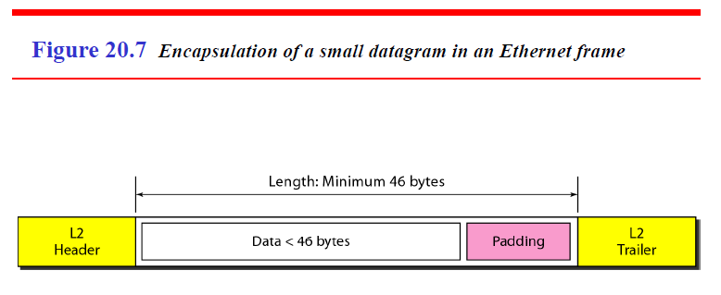
For example, the Ethernet protocol has a minimum and maximum
restriction on the size of data that can be encapsulated in a frame (46 to 1500 bytes).
If the size of an IPv4 datagram is less than 46 bytes, some padding will be added to meet this requirement.
In this case, when a machine decapsulates the datagram, it needs to check the total length field to determine how much is really data and how much is padding (see Figure 20.7).
19.<number>

Slide 35
5. Identification. This field is used in fragmentation.
6. Flags. This field is used in fragmentation
7. Fragmentation offset. This field is used in fragmentation.
8.Time to live. A datagram has a limited lifetime in its travel through an internet.
This field was originally designed to hold a timestamp, which was decremented by each visited router.
The datagram was discarded when the value became zero. However, for this scheme, all the machines must have synchronized clocks and must know how long it takes for a datagram to go from one machine to another.
Today, this field is used mostly to control the maximum number of hops (routers) visited by the datagram. When a source host sends the datagram, it stores a number in this field.
19.<number>

Slide 36
This value is approximately 2 times the maximum number of routes between any two hosts. Each router that processes the datagram decrements this number by 1.
If this value, after being decremented, is zero, the router discards the datagram.
This field is needed because routing tables in the Internet can become corrupted.
A datagram may travel between two or more routers for a long time without ever getting delivered to the destination host. This field limits the lifetime of a datagram.
Another use of this field is to intentionally limit the journey of the packet. For example, if the source wants to confine the packet to the local network, it can store 1 in this field. When the packet arrives at the first router, this value is decremented to 0, and the datagram is discarded.
19.<number>

Slide 37
9. Protocol. This 8-bit field defines the higher-level protocol that uses the services of the IPv4 layer.
An IPv4 datagram can encapsulate data from several higher-level protocols such as TCP, UDP, ICMP, and IGMP.
This field specifies the final destination protocol to which the IPv4 datagram is delivered.
In other words, since the IPv4 protocol carries data from different other protocols, the value of this field helps the receiving network layer know to which protocol the data belong (see Figure 20.8).
19.<number>

Slide 38
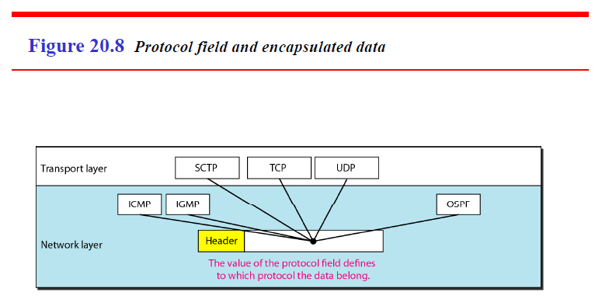
19.<number>

Slide 39
10. Checksum. A checksum is a count of the number of bits in a transmission unit that is included with the unit so that the receiver can check to see whether the same number of bits arrived. If the counts match, it's assumed that the complete transmission was received.
11. Source address. This 32-bit field defines the IPv4 address of the source. This field must remain unchanged during the time the IPv4 datagram travels from the source host to the destination host.
12. Destination address. This 32-bit field defines the IPv4 address of the destination. This field must remain unchanged during the time the IPv4 datagram travels from the source host to the destination host.
19.<number>

Slide 40
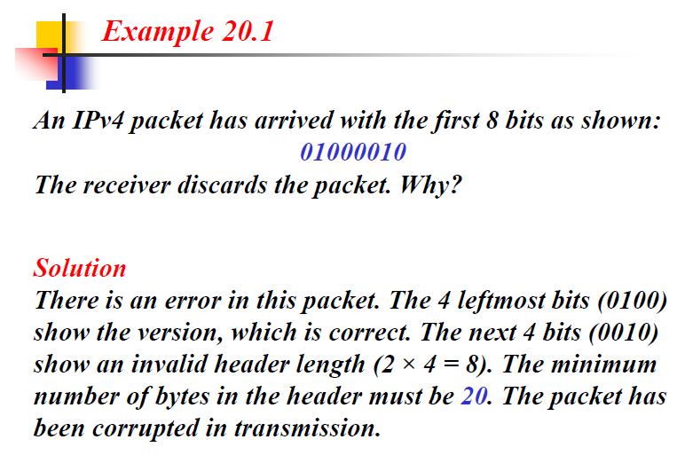
19.<number>

Slide 41
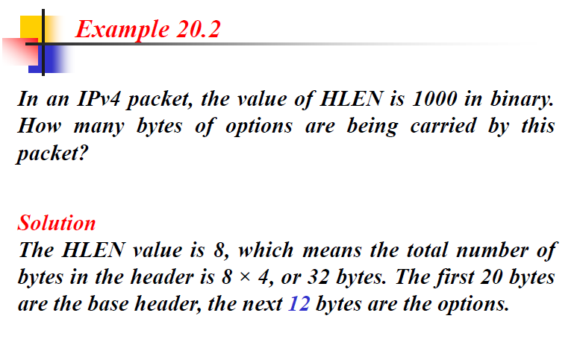
19.<number>

Slide 42
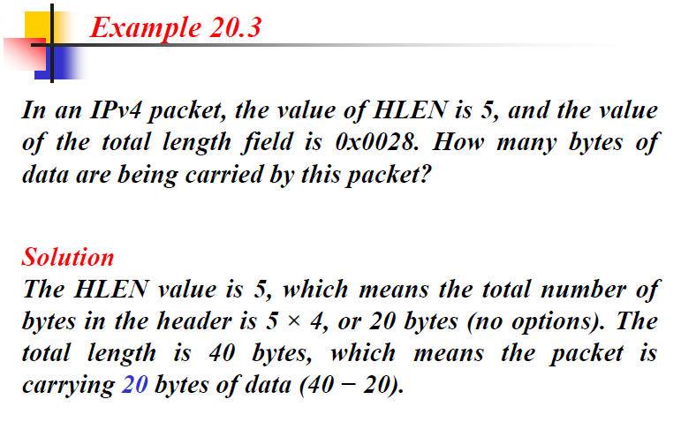
19.<number>

Slide 43
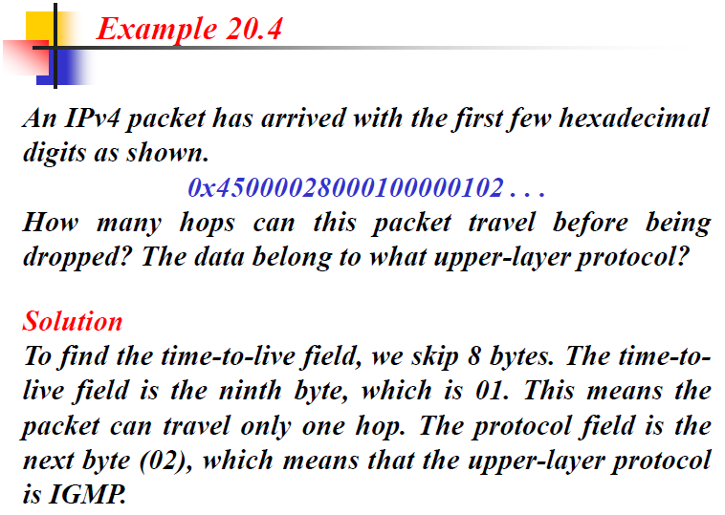
19.<number>

Slide 44
Fragmentation
A datagram can travel through different networks.
Each router decapsulates the IPv4 datagram from the frame it receives, processes it, and then encapsulates it in another frame.
The format and size of the received frame depend on the protocol used by the physical network through which the frame has just traveled.
The format and size of the sent frame depend on the protocol used by the physical network through which the frame is going to travel.
For example, if a router connects a LAN to a WAN, it receives a frame in the LAN format and sends a frame in the WAN format.
19.<number>

Slide 45
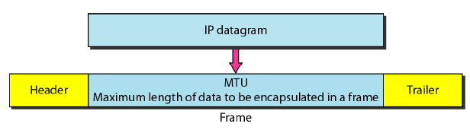
Each data link layer protocol has its own frame format in most protocols.
One of the fields defined in the format is the maximum size of the data field.
In other words, when a datagram is encapsulated in a frame, the total size of the datagram must be less than this maximum size, which is defined by the restrictions imposed by the hardware and software used in the network.
The value of the MTU depends on the physical network protocol.
19.<number>

Slide 46
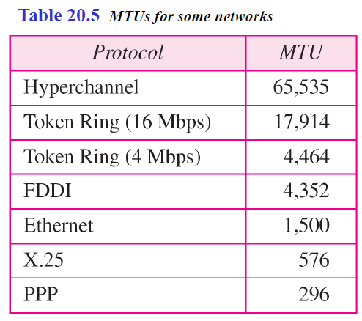
Table 20.5 shows the values for some protocols.
19.<number>

Slide 47
To make the IPv4 protocol independent of the physical network, the designers decided to make the maximum length of the IPv4 datagram equal to 65,535 bytes.
This makes transmission more efficient if we use a protocol with an MTU of this size.
However, for other physical networks, we must divide the datagram to make it possible to pass through these networks. This is called fragmentation.
The source usually does not fragment the IPv4 packet.
The transport layer will instead segment the data into a size that can be accommodated by IPv4 and the data link layer in use.
When a datagram is fragmented, each fragment has its own header with most of the fields repeated, but with some changed. A fragmented datagram may itself be fragmented if it encounters a network with an even smaller MTU.
In other words, a datagram can be fragmented several times before it reaches the final destination.
19.<number>

Slide 48
In IPv4, a datagram can be fragmented by the source host or any router in the path although there is a tendency to limit fragmentation only at the source.
The reassembly of the datagram, however, is done only by the destination host because each fragment becomes an independent datagram.
Whereas the fragmented datagram can travel through different routes, and we can never control or guarantee which route a fragmented datagram may take, all the fragments belonging to the same datagram should finally arrive at the destination host.
So it is logical to do the reassembly at the final destination.
An even stronger objection to reassembling packets during the transmission is the loss of efficiency it incurs.
19.<number>

Slide 49
When a datagram is fragmented, required parts of the header must be copied by all fragments.
The option field may or may not be copied.
The host or router that fragments a datagram must change the values of three fields:
flags, fragmentation offset, and total length.
The rest of the fields must be copied.
Of course, the value of the checksum must be recalculated regardless of fragmentation.
19.<number>

Slide 50
Fields Related to Fragmentation
The fields that are related to fragmentation and reassembly of an IPv4 datagram are the
1] identification, 2] flags, and 3] fragmentation offset fields.
19.<number>

Slide 51
1. Identification
This 16-bit field identifies a datagram originating from the source host.
The combination of the identification and source IPv4 address must uniquely
define a datagram as it leaves the source host.
To guarantee uniqueness, the IPv4 protocol uses a counter to label the datagrams.
The counter is initialized to a positive number. When the IPv4 protocol sends a datagram, it copies the current value of the counter to the identification field and increments the counter by 1.
As long as the counter is kept in the main memory, uniqueness is guaranteed.
When a datagram is fragmented, the value in the identification field is copied to all fragments.
In other words, all fragments have the same identification number, the same as the original datagram. The identification number helps the destination in reassembling the datagram. It knows that all fragments having the same identification value must be assembled into one datagram.
19.<number>

Slide 52
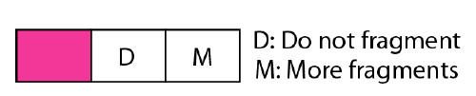
2. Flags
This is a 3-bit field.
The first bit is reserved.
The second bit is called the do Not fragment bit.
If its value is 1, the machine must not fragment the datagram.
If it cannot pass the datagram through any available physical network, it discards the datagram and sends an ICMP error message to the source host.
If its value is 0, the datagram can be fragmented if necessary.
The third bit is called the more fragment bit. If its value is 1, it means the datagram is not the last fragment; there are more fragments after this one. If its value is 0, it means this is the last or only fragment.
19.<number>

Slide 53
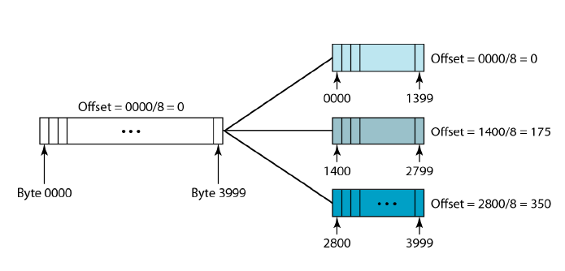
3. Fragmentation Offset
This 13-bit field shows the relative position of this fragment with respect to the whole datagram.
It is the offset of the data in the original datagram measured in units of 8 bytes.
19.<number>

Slide 54
Figure 20.11 shows a datagram with a data size of 4000 bytes fragmented into three fragments.
The bytes in the original datagram are numbered 0 to 3999.
The first fragment carries bytes 0 to 1399.
The offset for this datagram is 0/8 =0. The second fragment carries bytes 1400 to 2799; the offset value for this fragment is 1400/8 = 175.
Finally, the third fragment carries bytes 2800 to 3999. The offset value for this fragment is 2800/8 =350.
Remember that the value of the offset is measured in units of 8 bytes.
This is done because the length of the offset field is only 13 bits and cannot represent a sequence of bytes greater than 8191.
This forces hosts or routers that fragment datagrams to choose a fragment size so that the first byte number is divisible by 8.
19.<number>

Slide 55
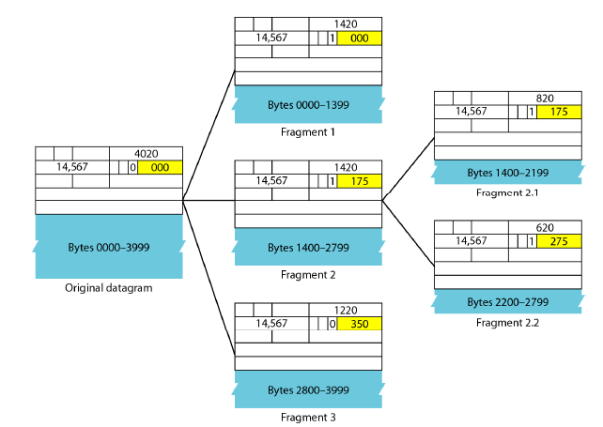
Figure 20.12 shows an expanded view of the fragments in Figure 20.11.
19.<number>

Slide 56
Notice the value of the identification field is the same in all fragments.
Notice the value of the flags field with the more bit set for all fragments except the last.
Also, the value of the offset field for each fragment is shown.
The figure also shows what happens if a fragment itself is fragmented.
In this case the value of the offset field is always relative to the original datagram.
For example, in the figure, the second fragment is itself fragmented later to two fragments of 800 bytes and 600 bytes, but the offset shows the relative position of the fragments to the original data.
19.<number>

Slide 57
It is obvious that even if each fragment follows a different path and arrives out
of order, the final destination host can reassemble the original datagram from the fragments received (if none of them is lost) by using the following strategy:
1. The first fragment has an offset field value of zero.
2. Divide the length of the first fragment by 8. The second fragment has an offset value equal to that result.
3. Divide the total length of the first and second fragments by 8. The third fragment has an offset value equal to that result.
4. Continue the process. The last fragment has a more bit value of O.
19.<number>

Slide 58
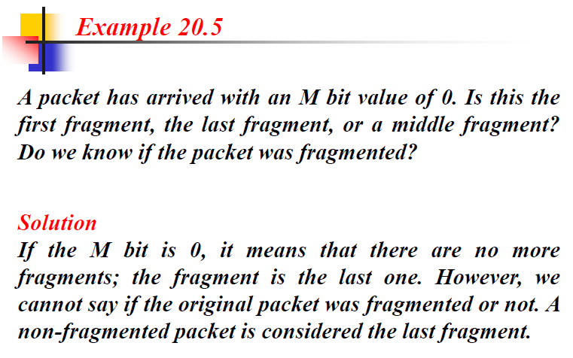
19.<number>

Slide 59
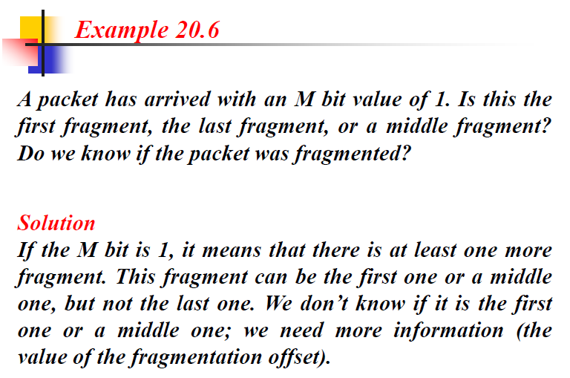
19.<number>

Slide 60
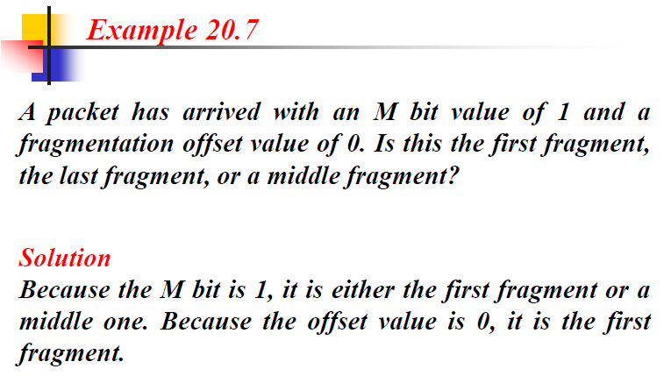
19.<number>

Slide 61
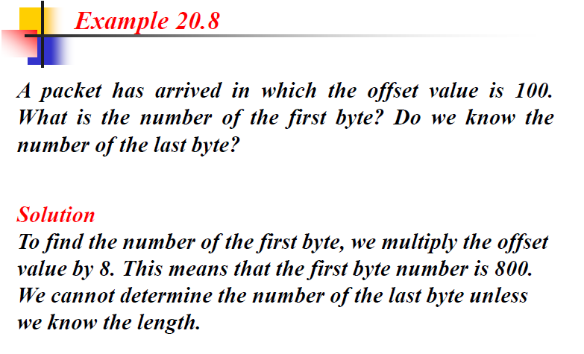
19.<number>

Slide 62
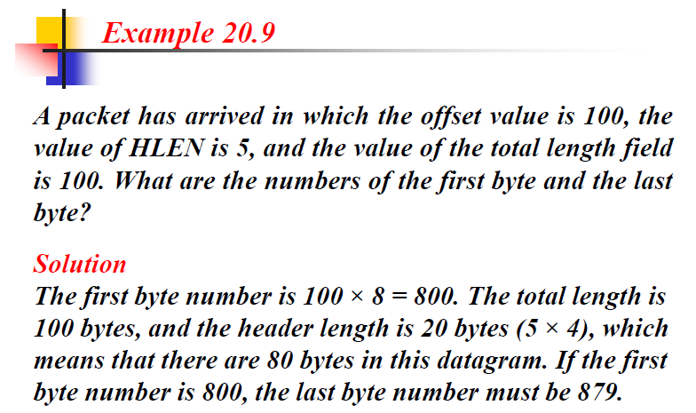
19.<number>

Slide 63
Checksum
The implementation of the checksum in the IPv4 packet follows the same principles.
A checksum is a count of the number of bits in a transmission unit that is included with the unit so that the receiver can check to see whether the same number of bits arrived. If the counts match, it's assumed that the complete transmission was received.
First, the value of the checksum field is set to O.
Then the entire header is divided into 16-bit sections and added together.
The result (sum) is complemented and inserted into the checksum field.
The checksum in the IPv4 packet covers only the header, not the data.
19.<number>

Slide 64
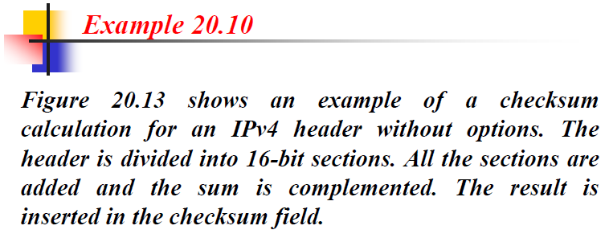
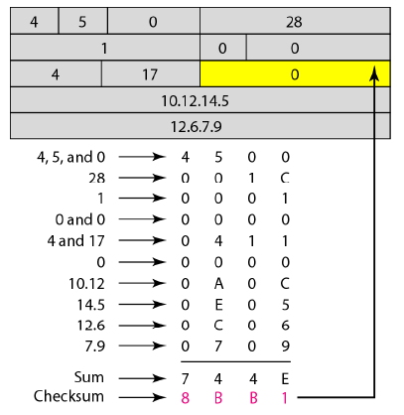
19.<number>

Slide 65
Options
The header of the IPv4 datagram is made of two parts: a fixed part and a variable part.
The fixed part is 20 bytes long.
The variable part comprises the options that can be a maximum of 40 bytes.
Options, as the name implies, are not required for a datagram.
They can be used for network testing and debugging.
Although options are not a required part of the IPv4 header, option processing is required of the IPv4 software.
This means that all implementations must be able to handle options if they are present in the header.
19.<number>

Slide 66
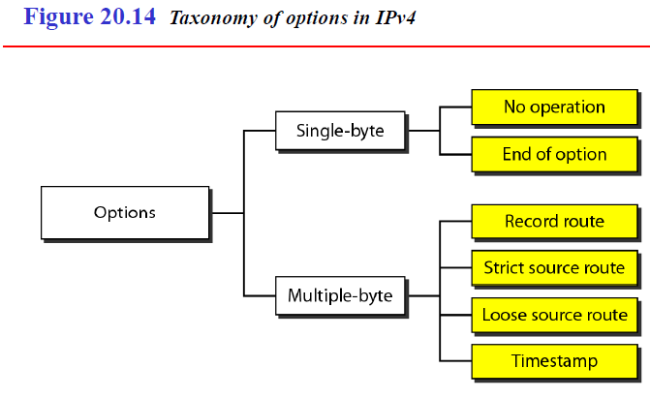
Taxonomy of options
19.<number>

Slide 67
End of Option
An end-of-option option is a 1-byte option used for padding at the end of the option field. It, however, can only be used as the last option.
2. Record Route
A record route option is used to record the Internet routers that handle the datagram.
It can list up to nine router addresses. It can be used for debugging and management purposes.
19.<number>

Slide 68
3. Strict Source Route
A strict source route option is used by the source to predetermine a route for the datagram as it travels through the Internet.
Dictation of a route by the source can be useful for several purposes. The sender can choose a route with a specific type of service, such as minimum delay or maximum throughput.
Alternatively, it may choose a route that is safer or more reliable for the sender's purpose.
For example, a sender can choose a route so that its datagram does not travel through a competitor's network.
If a datagram specifies a strict source route, all the routers defined in the option
must be visited by the datagram.
A router must not be visited if its IPv4 address is not listed in the datagram. If the datagram visits a router that is not on the list, the datagram is discarded and an error message is issued. If the datagram arrives at the destination and some of the entries were not visited, it will also be discarded and an error message issued.
19.<number>

Slide 69
4. Loose Source Route
A loose source route option is similar to the strict source route, but it is less rigid. Each
router in the list must be visited, but the datagram can visit other routers as well.
5. Timestamp
A timestamp option is used to record the time of datagram processing by a router.
The time is expressed in milliseconds from midnight, Universal time or Greenwich mean time.
Knowing the time a datagram is processed can help users and managers track the behavior of the routers in the Internet. We can estimate the time it takes for a datagram to go from one router to another.
We say estimate because, although all routers may use Universal time, their local clocks may not be synchronized.
19.<number>

Slide 70
IPv6
The network layer protocol in the TCPIIP protocol suite is currently IPv4 (Internetworking Protocol, version 4).
IPv4 provides the host-to-host communication between
systems in the Internet.
Although IPv4 is well designed, data communication has
evolved since the inception of IPv4 in the 1970s.
IPv4 has some deficiencies (listed below) that make it unsuitable for the fast-growing Internet.
19.<number>

Slide 71
Despite all short-term solutions, such as subnetting, classless addressing, and NAT, address depletion is still a long-term problem in the Internet.
The Internet must accommodate real-time audio and video transmission. This type of transmission requires minimum delay strategies and reservation of resources not provided in the IPv4 design.
The Internet must accommodate encryption and authentication of data for some applications. No encryption or authentication is provided by IPv4.
19.<number>

Slide 72
To overcome these deficiencies, IPv6 (Internetworking Protocol, version 6), also known as IPng (Internetworking Protocol, next generation), was proposed and is now a standard.
In IPv6, the Internet protocol was extensively modified to accommodate
the unforeseen growth of the Internet.
The format and the length of the IP address were changed along with the packet format.
Related protocols, such as ICMP, were also modified. Other protocols in the network layer, such as ARP, RARP, and IGMP, were either deleted or included in the ICMPv6 protocol.
Routing protocols, such as RIP and OSPF were also slightly modified to accommodate these changes.
Communications experts predict that IPv6 and its related protocols will
soon replace the current IP version.
19.<number>

Slide 73
The adoption of IPv6 has been slow.
The reason is that the original motivation for its development, depletion of IPv4 addresses, has been remedied by short-term strategies such as classless addressing and NAT.
However, the fast-spreading use of the Internet, and new services such as mobile IP, IP telephony, and IP-capable mobile telephony, may eventually require the total replacement of IPv4 with IPv6.
19.<number>

Slide 74
Advantages
The next-generation IP, or IPv6, has some advantages over IPv4 that can be summarized as follows:
1. Larger address space. An IPv6 address is 128 bits long. Compared with the 32-bit address of IPv4, this is a huge (2⁹⁶) increase in the address space.
2. Better header format. IPv6 uses a new header format in which options are separated from the base header and inserted, when needed, between the base header and the upper-layer data. This simplifies and speeds up the routing process because most of the options do not need to be checked by routers.
3.New options. IPv6 has new options to allow for additional functionalities.
4. Allowance for extension. IPv6 is designed to allow the extension of the protocol if required by new technologies or applications.
19.<number>

Slide 75
5. Support for resource allocation. In IPv6, the type-of-service field has been removed, but a mechanism (called flow label) has been added to enable the source to request special handling of the packet. This mechanism can be used to support traffic such as real-time audio and video.
6.Support for more security. The encryption and authentication options in IPv6 provide confidentiality and integrity of the packet.
19.<number>

Slide 76
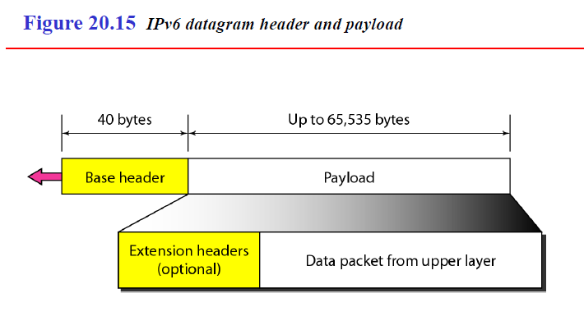
Packet Format
The IPv6 packet is shown in Figure 20.15. Each packet is composed of a mandatory base header followed by the payload.
The payload consists of two parts: optional extension headers and data from an upper layer. The base header occupies 40 bytes, whereas the extension headers and data from the upper layer contain up to 65,535 bytes of information.
19.<number>

Slide 77
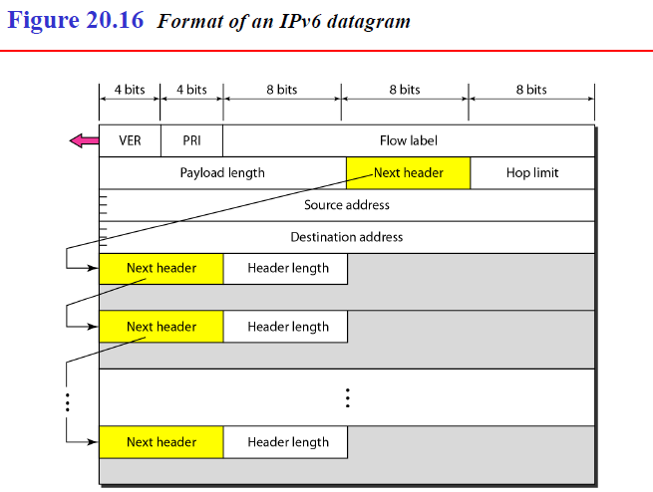
Base Header
19.<number>

Slide 78
Figure 20.16 shows the base header with its eight fields.
These fields are as follows:
1.Version. This 4-bit field defines the version number of the IP. For IPv6, the value is 6.
2.Priority. The 4-bit priority field defines the priority of the packet with respect to traffic congestion.
3.Flow label. The flow label is a 3-byte (24-bit) field that is designed to provide special handling for a particular flow of data.
4.Payload length. The 2-byte payload length field defines the length of the IP datagram excluding the base header.
5.Next header. The next header is an 8-bit field defining the header that follows the base header in the datagram. The next header is either one of the optional extension headers used by IP or the header of an encapsulated packet such as UDP or TCP. Each extension header also contains this field. Table 20.6 shows the values of next headers. Note that this field in version 4 is called the protocol.
19.<number>

Slide 79
6.Hop limit. This 8-bit hop limit field serves the same purpose as the TTL field in IPv4.
7.Source address. The source address field is a 16-byte (128-bit) Internet address that identifies the original source of the datagram.
8.Destination address. The destination address field is a 16-byte (128-bit) Internet address that usually identifies the final destination of the datagram. However, if source routing is used, this field contains the address of the next router.
19.<number>

Slide 80
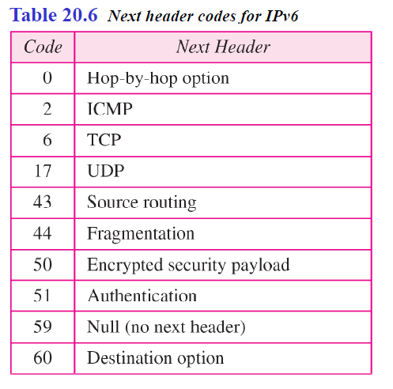
19.<number>

Slide 81
Priority
The priority field of the IPv6 packet defines the priority of each packet with respect to other packets from the same source.
For example, if one of two consecutive datagrams must be discarded due to congestion, the datagram with the lower packet priority will be discarded.
IPv6 divides traffic into two broad categories: congestion-controlled and noncongestion-controlled.
19.<number>

Slide 82
Congestion-Controlled Traffic
If a source adapts itself to traffic slowdown when there is congestion, the traffic is referred to as congestion-controlled traffic.
For example, TCP, which uses the sliding window protocol, can easily respond to traffic.
In congestion-controlled traffic, it is understood that packets may arrive delayed, lost, or out of order.
Congestion-controlled data are assigned priorities from 0 to 7, as listed in Table 20.7.
A priority of 0 is the lowest; a priority of 7 is the highest.
19.<number>

Slide 83
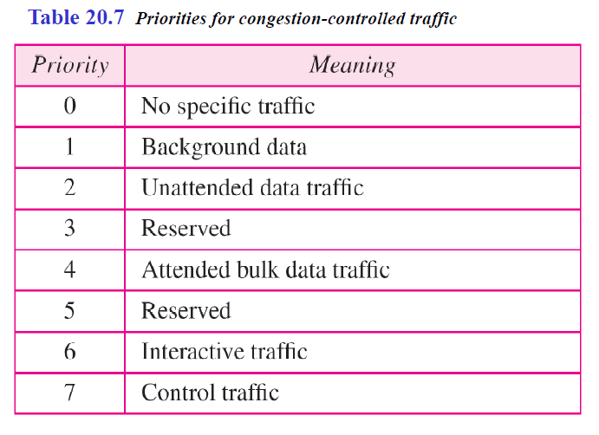
19.<number>

Slide 84
The priority descriptions are as follows:
1 No specific traffic. A priority of 0 is assigned to a packet when the process does not define a priority.
2 Background data. This group (priority 1) defines data that are usually delivered in the background. Delivery of the news is a good example.
3 Unattended data traffic. If the user is not waiting (attending) for the data to be received, the packet will be given a priority of 2. E-mail belongs to this group. The recipient of an e-mail does not know when a message has arrived. In addition, an e-mail is usually stored before it is forwarded. A little bit of delay is of little consequence.
4 Attended bulk data traffic. A protocol that transfers data while the user is waiting (attending) to receive the data (possibly with delay) is given a priority of 4. FTP and HTTP belong to this group.
19.<number>

Slide 85
5 Interactive traffic. Protocols such as TELNET that need user interaction are assigned the second-highest priority (6) in this group.
6 Control traffic. Control traffic is given the highest priority (7). Routing protocols such as OSPF and RIP and management protocols such as SNMP have this priority.
19.<number>

Slide 86
Non congestion-Controlled Traffic
This refers to a type of traffic that expects minimum delay. Discarding of packets is not desirable.
Retransmission in most cases is impossible. In other words, the source does not adapt itself to congestion.
Real-time audio and video are examples of this type of traffic.
Priority numbers from 8 to 15 are assigned to noncongestion-controlled traffic.
Although there are not yet any particular standard assignments for this type of data, the priorities are usually based on how much the quality of received data is affected by the discarding of packets.
19.<number>

Slide 87
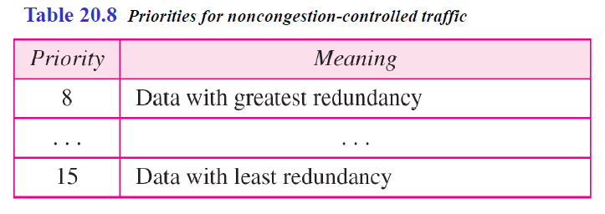
Data containing less redundancy (such as low-fidelity audio or video) can be given a higher priority (15).
Data containing more redundancy (such as high-fidelity audio or video) are given a lower priority (8). See Table 20.8.
19.<number>

Slide 88
Flow Label
A sequence of packets, sent from a particular source to a particular destination, that needs special handling by routers is called a flow of packets.
The combination of the source address and the value of the flow label uniquely defines a flow of packets.
To a router, a flow is a sequence of packets that share the same characteristics, such as traveling the same path, using the same resources, having the same kind of security, and so on.
A router that supports the handling of flow labels has a flow label table.
The table has an entry for each active flow label; each entry defines the services required by the corresponding flow label.
19.<number>

Slide 89
When the router receives a packet, it consults its flow label table to find the corresponding entry for the flow label value defined in the packet.
It then provides the packet with the services mentioned in the entry.
However, note that the flow label itself does not provide the information for the entries of the flow label table; the information is provided by other means such as the hop-by-hop options or other protocols.
In its simplest form, a flow label can be used to speed up the processing of a packet by a router.
19.<number>

Slide 90
When a router receives a packet, instead of consulting the routing table and going through a routing algorithm to define the address of the next hop, it can easily look in a flow label table for the next hop.
In its more sophisticated form, a flow label can be used to support the transmission of real-time audio and video.
Real-time audio or video, particularly in digital form, requires resources such as high bandwidth, large buffers, long processing time, and so on.
A process can make a reservation for these resources beforehand to guarantee that real-time data will not be delayed due to a lack of resources.
The use of real-time data and the reservation of these resources require other protocols such as Real-Time Protocol (RTP) and Resource Reservation Protocol (RSVP) in addition to IPv6.
19.<number>

Slide 91
To allow the effective use of flow labels, three rules have been defined:
The flow label is assigned to a packet by the source host. The label is a random number between 1 and 2²⁴ - 1.
A source must not reuse a flow label for a new flow while the existing flow is still active.
2. If a host does not support the flow label, it sets this field to zero.
If a router does not support the flow label, it simply ignores it.
3. All packets belonging to the same flow have the same source, same destination, same priority, and same options.
19.<number>

Slide 92
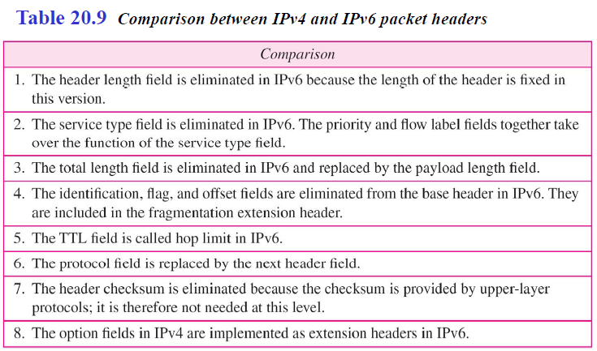
Comparison Between IPv4 and IPv6 Headers
19.<number>

Slide 93
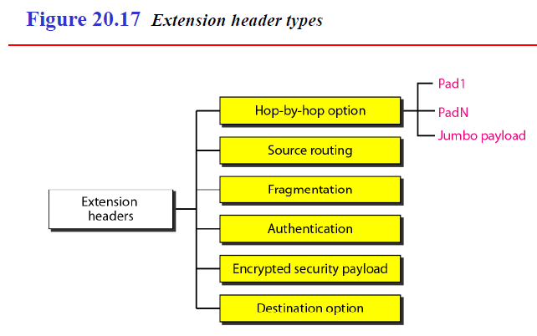
Extension Headers
The length of the base header is fixed at 40 bytes. However, to give greater functionality to the IP datagram, the base header can be followed by up to six extension headers.
Many of these headers are options in IPv4. Six types of extension headers have been defined, as shown in Figure 20.17.
19.<number>

Slide 94
Hop-by-Hop Option
The hop-by-hop option is used when the source needs to pass information to all routers visited by the datagram.
So far, only three options have been defined: Pad1, PadN, and jumbo payload.
The Pad1 option is 1 byte long and is designed for alignment purposes.
PadN is similar in concept to Pad1.
The difference is that PadN is used when 2 or more bytes is needed for alignment.
The jumbo payload option is used to define a payload longer than 65,535 bytes.
2. Source Routing The source routing extension header combines the concepts of the strict source route and the loose source route options of IPv4.
19.<number>

Slide 95
3. Fragmentation
The concept of fragmentation is the same as that in IPv4.
However, the place where fragmentation occurs differs.
In IPv4, the source or a router is required to fragment if the size of the datagram is larger than the MTU of the network over which the datagram travels.
In IPv6, only the original source can fragment.
A source must use a path MTU discovery technique to find the smallest MTU supported by any network on the path.
The source then fragments using this knowledge.
19.<number>

Slide 96
4. Authentication
The authentication extension header has a dual purpose: it validates the message sender and ensures the integrity of data.
5. Encrypted Security Payload
The encrypted security payload (ESP) is an extension that provides confidentiality and guards against eavesdropping.
6. Destination Option
The destination option is used when the source needs to pass information to the destination only. Intermediate routers are not permitted access to this information.
19.<number>

Slide 97
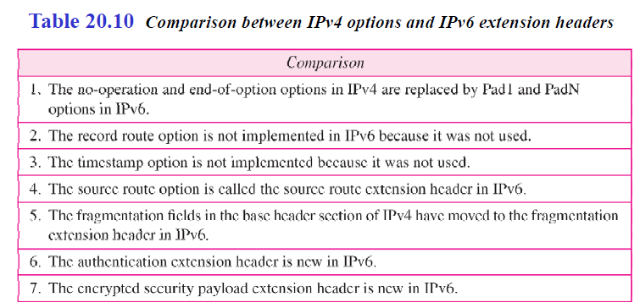
Comparison Between IPv4 Options
and IPv6 Extension Headers
19.<number>

Slide 98
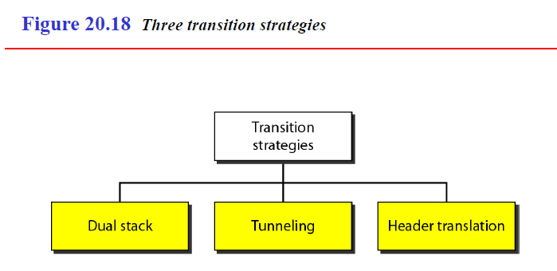
Transition From IPv4 to IPv6
Because of the huge number of systems on the Internet, the transition from IPv4 to IPv6 cannot happen suddenly.
It takes a considerable amount of time before every system in the Internet can move from IPv4 to IPv6.
The transition must be smooth to prevent any problems between IPv4 and IPv6 systems. Three strategies have been devised by the IElF to help the transition (see Figure 20.18).
19.<number>

Slide 99
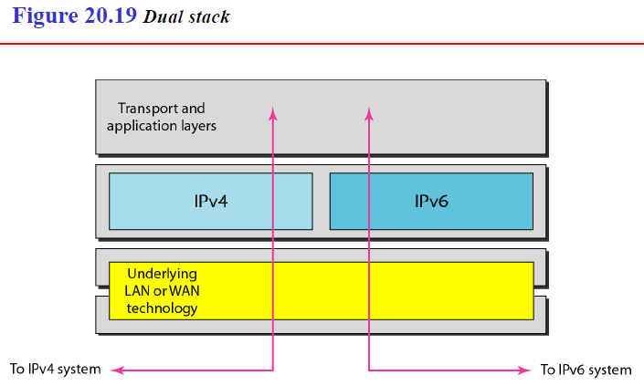
1. Dual Stack
It is recommended that all hosts, before migrating completely to version 6, have a dual stack of protocols.
In other words, a station must run IPv4 and IPv6 simultaneously until all the Internet uses IPv6. See Figure 20.19 for the layout of a dual-stack configuration.
19.<number>

Slide 100
To determine which version to use when sending a packet to a destination, the source host queries the DNS.
If the DNS returns an IPv4 address, the source host sends an IPv4 packet.
If the DNS returns an IPv6 address, the source host sends an IPv6 packet.
19.<number>

Slide 101
2. Tunneling
Tunneling is a strategy used when two computers using IPv6 want to communicate
with each other and the packet must pass through a region that uses IPv4.
To pass through this region, the packet must have an IPv4 address.
So Tunneling is a strategy used when two computers using IPv6 want to communicate with each other and the packet must pass through a region that uses IPv4.
To pass through this region, the packet must have an IPv4 address. So the IPv6 packet is encapsulated in an IPv4 packet when it enters the region, and it leaves its capsule when it exits the region.
It seems as if the IPv6 packet goes through a tunnel at one end and emerges at the other end.
To make it clear that the IPv4 packet is carrying an IPv6 packet as data, the protocol value is set to 41.
19.<number>

Slide 102
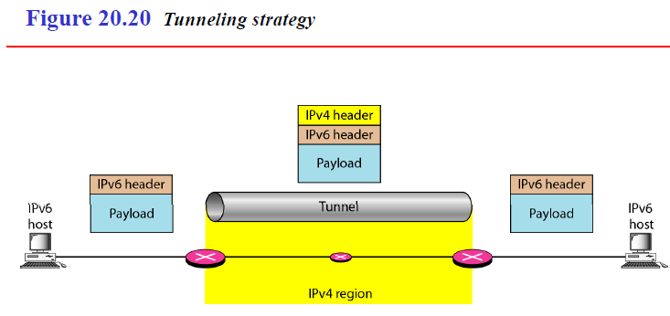
19.<number>

Slide 103
3. Header Translation
Header translation is necessary when the majority of the Internet has moved to IPv6 but some systems still use IPv4.
The sender wants to use IPv6, but the receiver does not understand IPv6.
Tunneling does not work in this situation because the packet must be in the IPv4 format to be understood by the receiver.
In this case, the header format must be totally changed through header translation.
The header of the IPv6 packet is converted to an IPv4 header (see Figure 20.21).
19.<number>

Slide 104
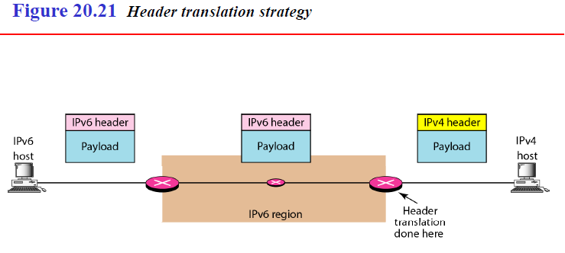
19.<number>

Slide 105
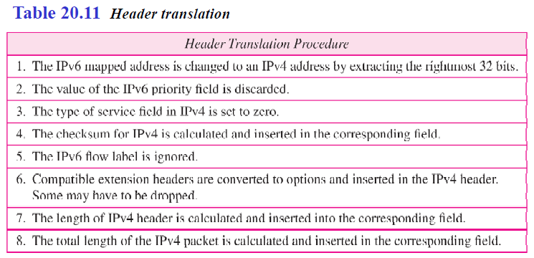
Header translation uses the mapped address to translate an IPv6 address to an IPv4 address.
Table 20.11 lists some rules used in transforming an IPv6 packet header to an
IPv4 packet header.
19.<number>

